Slide 1


DEVL MINI-PROJECT
A PRELIMINARY MINI PROJECT REPORT ON
Analysis of Natural Disasters Using EDA and Visualization
Prepared by:
Shyam Sundar Yadav (123B1B267)
Siddhartha Kumar Nidhi (123B1B268)
Sujit Chaudhary (123B1B272)
Varun Goyal (123B1B278)

Slide 2
Introduction
Natural disasters are devastating events that significantly impact communities, economies, and environments. Analyzing past events provides critical insights for improving disaster response and preparedness. This project uses a dataset from Kaggle containing information on various natural disasters, allowing for the analysis of patterns and impacts over time.
The objectives of this study is to :
Analyze the frequency of different types of natural disasters over time.
Assess the impact of these disasters by measuring total deaths and economic damage.
Identify patterns in disaster occurrences and their geographic distribution.

Slide 3
A brief Overview of Dataset
DisNo.: Unique identifier for each disaster event.
Historic: Indicates if the disaster event is historic.
Classification Key: Classification code representing the disaster’s nature.
Disaster Group: Broad category of the disaster (e.g., Natural, Technological).
Disaster Subgroup: Subcategory within the disaster group.
Disaster Type: Specific disaster type within the subgroup.
Disaster Subtype: Further classification within the disaster type.
External IDs: External identification codes for the disaster.
Event Name: Name given to the disaster event, if available.
ISO: ISO country code of the affected region.
Country: Name of the affected country.
Subregion: Subregional classification within the affected country.
Region: Geographical region classification.
Location: Specific location details of the disaster.
Origin: The origin or cause of the disaster.
Associated Types: Other disaster types associated with the event.
OFDA/BHA Response: Indicates if there was a response from the U.S. Office of Foreign Disaster Assistance (OFDA) or Bureau for Humanitarian Assistance (BHA).
Appeal: Indicates if an appeal for aid was made.
Declaration: Declaration status for international aid or emergency.
AID Contribution ('000 US$): Aid contribution received in thousands of US dollars.
Magnitude: Magnitude of the disaster (e.g., intensity for earthquakes).
Magnitude Scale: Scale used to measure the disaster magnitude.
Latitude: Latitude of the disaster location.
Longitude: Longitude of the disaster location.
River Basin: River basin affected, if applicable.
Start Year: Year the disaster started.
Start Month: Month the disaster started.
Start Day: Day the disaster started.
End Year: Year the disaster ended.
Start Day: Day the disaster started.
End Year: Year the disaster ended.
End Month: Month the disaster ended.
End Day: Day the disaster ended.
Total Deaths: Total deaths reported from the disaster.
No. Injured: Number of people injured in the disaster.
No. Affected: Number of people affected by the disaster.
No. Homeless: Number of people rendered homeless by the disaster.
Total Affected: Total number of people affected (including injured and homeless).
Reconstruction Costs ('000 US$): Estimated reconstruction costs in thousands of US dollars.
Reconstruction Costs, Adjusted ('000 US$): Inflation-adjusted reconstruction costs.
Insured Damage ('000 US$): The total amount of damage covered by insurance in thousands of US dollars.
Insured Damage, Adjusted ('000 US$): Inflation-adjusted insured damage costs.
Total Damage ('000 US$): The total economic damage caused by the disaster in thousands of US dollars.
Total Damage, Adjusted ('000 US$): Inflation-adjusted total damage costs.
CPI: The Consumer Price Index used for adjusting monetary values in the dataset.
Admin Units: The administrative regions (e.g., states, provinces) affected by the disaster.
Entry Date: The date when the disaster record was entered into the dataset.
Last Update: The date when the disaster record was last updated

Slide 4
Identifying Total Unique Disasters
Extreme temperature
Road
Fire (Miscellaneous)
Storm
Earthquake
Rail
Collapse (Industrial)
Flood
Epidemic
Air
Mass movement (wet)
Volcanic activity
Explosion (Industrial)
Explosion (Miscellaneous)
Wildfire
Gas leak
Water
Fire (Industrial)
Miscellaneous accident (General)
Poisoning
Collapse (Miscellaneous)‘
Mass movement (dry)
Drought
Industrial accident (General)
Infestation
Chemical spill
Radiation
Oil spill
Glacial lake outburst flood

Slide 5
Our approach
REMOVING THE UNWANTED COLUMNS FROM THE DATASET THAT WON’T HELP IN PREDICTION MODEL
After removing we have these columns left:
DisNo.
Historic
Classification Key
Disaster Group
Disaster Subgroup
Disaster Type
Disaster Subtype
ISO
Country
Subregion Magnitude
Magnitude Scale
Latitude
Longitude
Start Year
Start Month
End Year
End Month
Total Deaths
No. Injured
No. Affected
No. Homeless
Total Affected
Total Damage ('000 US$)
Total Damage, Adjusted ('000 US$)

Slide 6
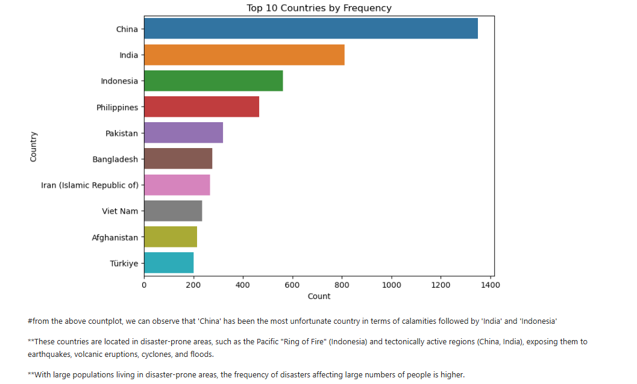

Slide 7
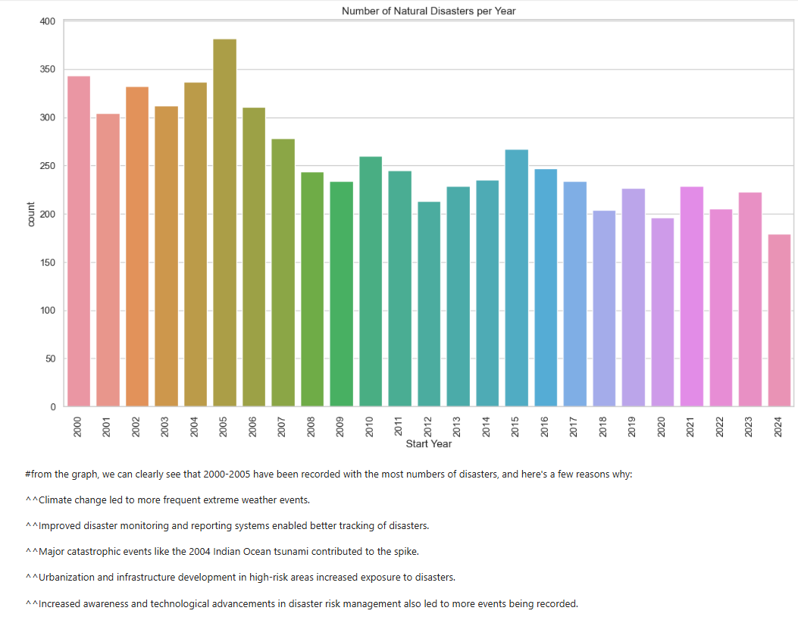

Slide 8
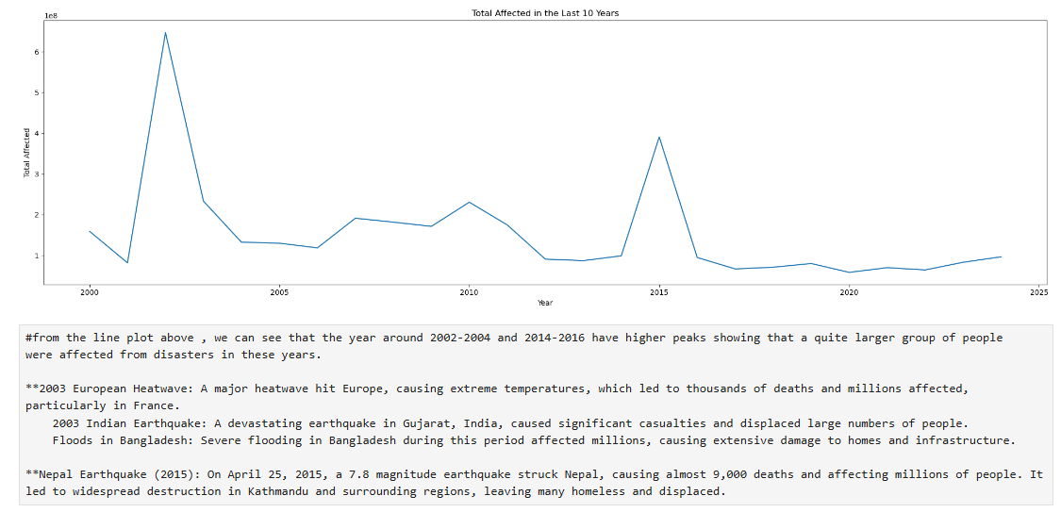

Slide 9
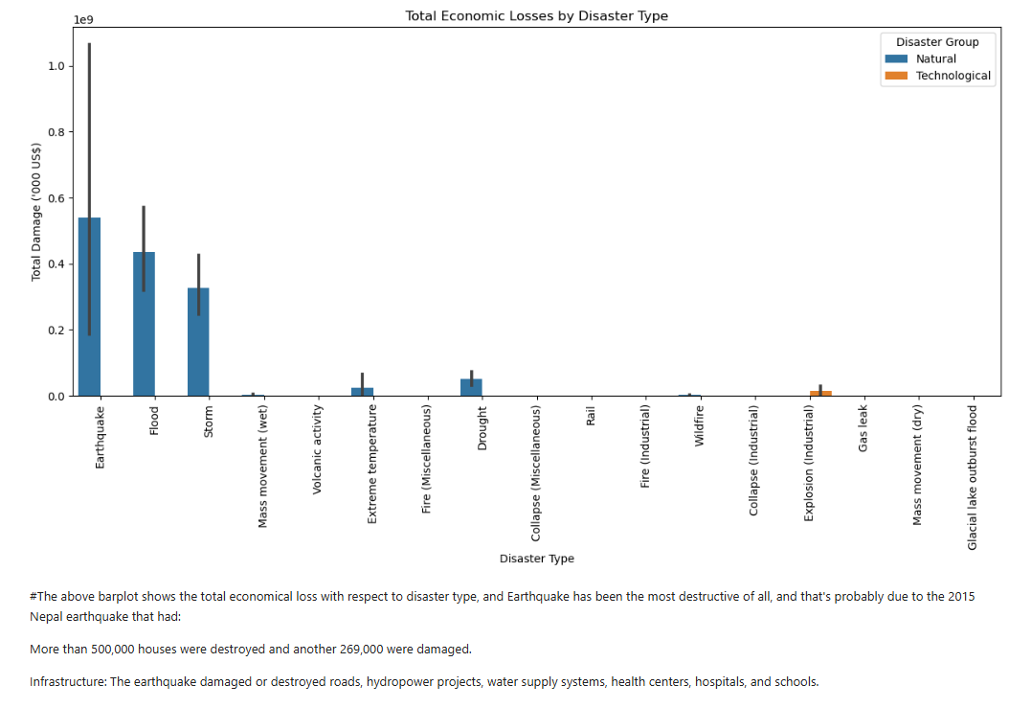

Slide 10
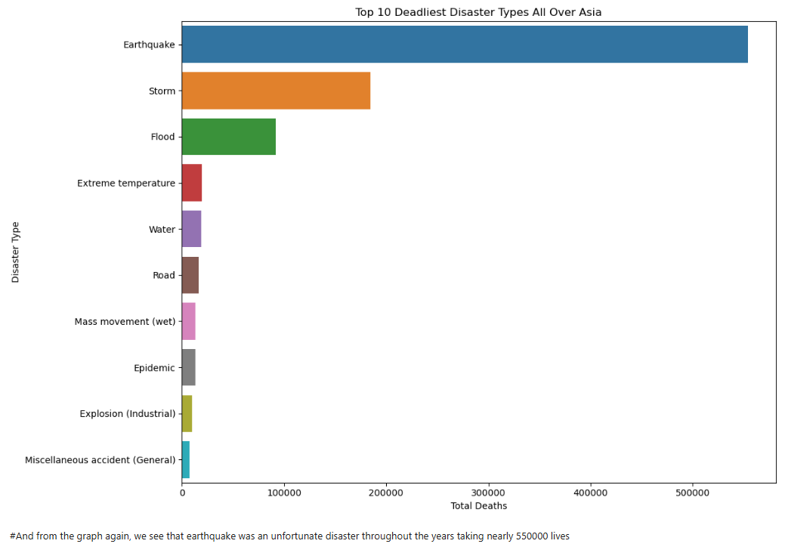

Slide 11
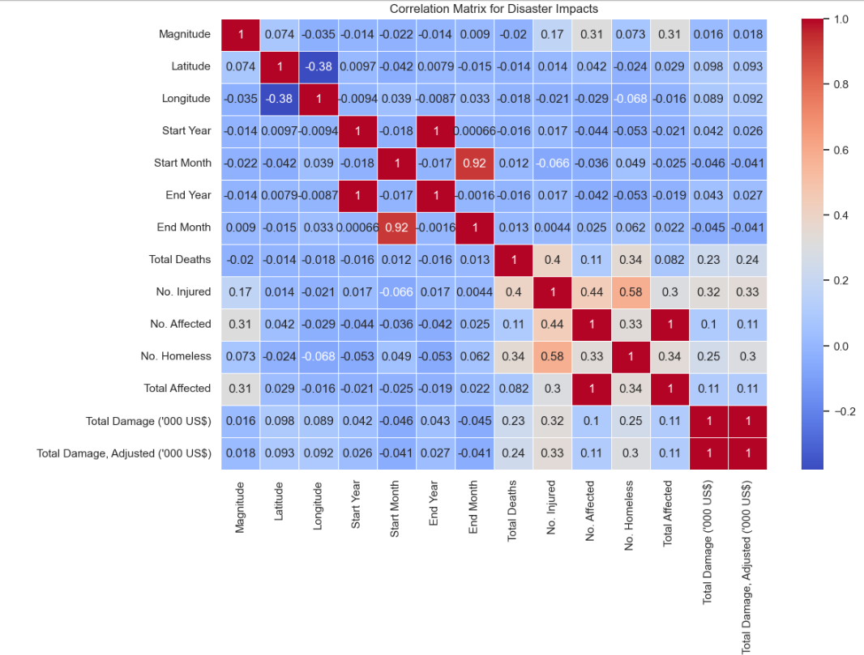

Slide 12
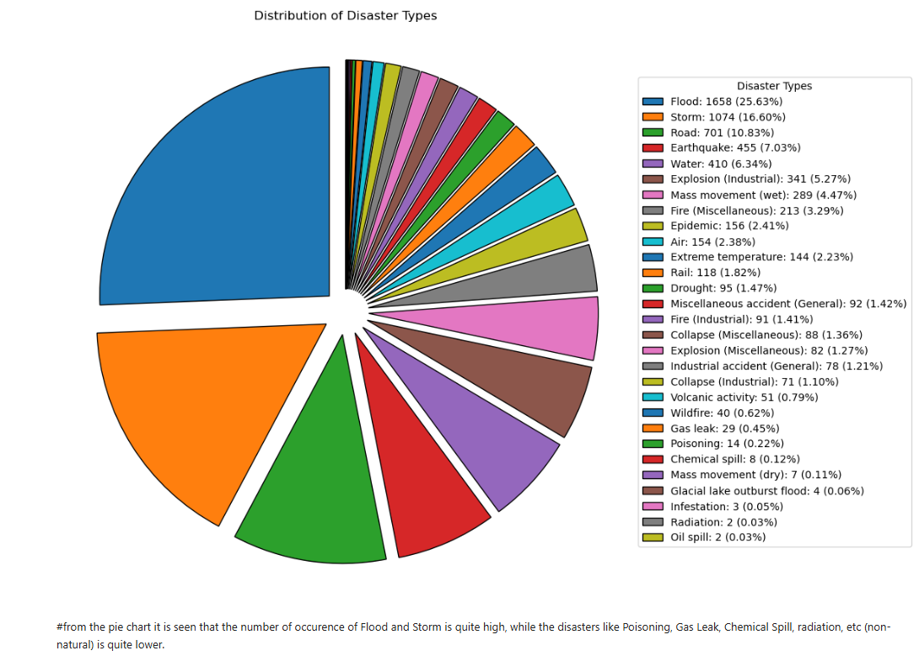

Slide 13
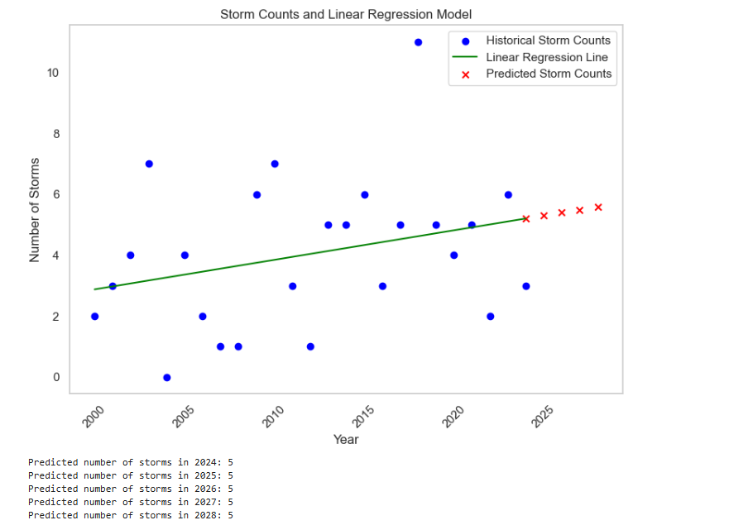

Slide 14
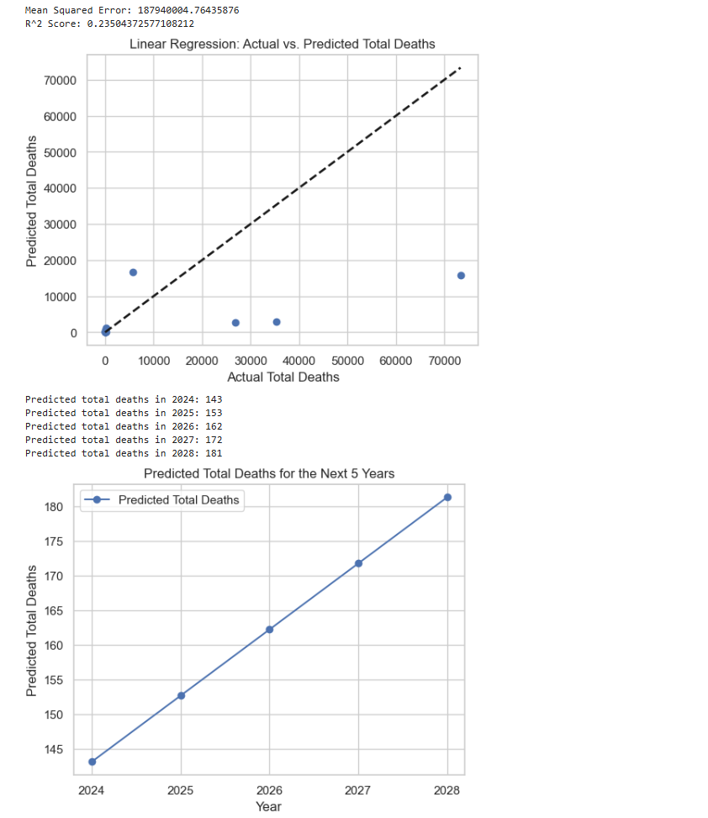

Slide 15
